Slide 1
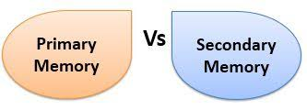
Chapter 3 part 1 Memory and Storage Devices
أعداد:م.م. أحمد عبد الإله العاشور
كلية الصيدلة-جامعة البصرة

Slide 2
Memory
Computer memory is the storage space in computer where data is to be processed and instructions required for processing are stored.
The memory is divided into large number of small parts called cells. Each location or cell has a unique address which varies from zero to memory size minus one.

Slide 4
The kinds of memory
We have 3 kinds of memories-:
1. RAM (Random Access Memory).
2. ROM (Read Only Memory).
3. Cash Memory.

Slide 5
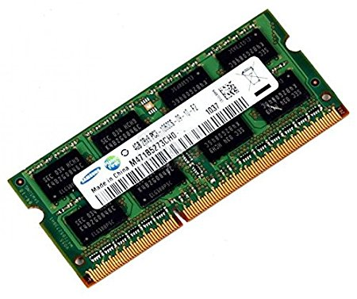
The kinds of memory
1.RAM(Random Access Memory):-
The main memory in the computer, it’s the location where data and programs are currently processed and stored (temporally).
RAM laptop

Slide 6
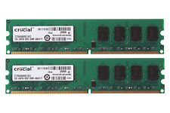
The kinds of memory
RAM is volatile” means that the data is only there while the computer is turned ,when the computer is shout off the content of the RAM is erased.
memory speed is measured in (MHz).
RAM PC

Slide 7
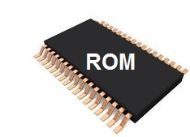
The kinds of memory
2. ROM (Read Only Memory)
It’s another part of the main memory, but with very small capacity to keep the instruction(BIOS) which make computer work when turning it on.
It’s not volatile and the computer can’t write on it.

Slide 8
The kinds of memory
3. Cash Memory: -
a. It’s linked to C.P.U. , It has very fast chip keeps
frequently used program and data, therefore it
increase the speed of the computer.
b. It reduces the gap speed of computer.

Slide 9
Storage Devices
Secondary memory or Secondary storage system, includes the disk and other storage media used to store data permanently to keep your software programs and application programs.
You have to save your work on storage devices before shutting the computer down.

Slide 10
Kind of storage devices
1. Hard Drive Disk(HDD).
2. Compact Disk (CD Rom ).
3. Compact Disc-Recordable (CD-R).
4. Digital Versatile Disk (DVD).
5. Flash Memory.

Slide 11
Kind of storage devices
1. Hard disk:-
* It’s the most important storage media in the computer, it keeps software programs and application programs, it composed of several magnetic disks in single unit.
* Hard drives store operating systems and programs as well as data files such as photographs, videos, and documents.

Slide 12
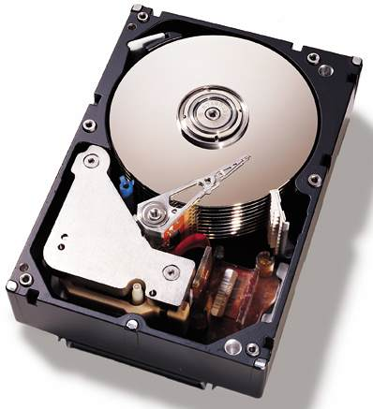
Kind of storage devices
A) An internal hard drive is connected directly to the
motherboard and other components inside the
laptop casing or desktop tower .

Slide 13
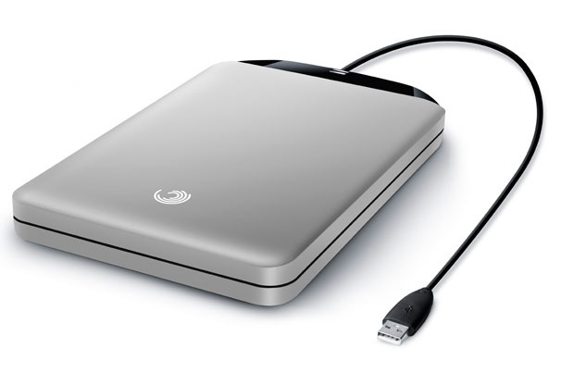
Kind of storage devices
B) An external hard drive has its own casing, and
connects to the computer with a input port.

Slide 14
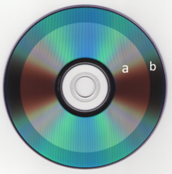
Kind of storage devises
2- Compact Disk (CD Rom ):-
It’s an important disk which was a LASER to read the information it’s suitable for storage programs that mix of (Text, graphic and audio)
capacity around 700 MB.
A-Filled
B-free space

Slide 15
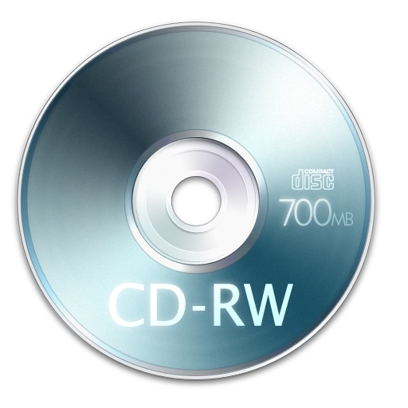
Kind of storage devises
3- Compact Disc-Recordable (CD-R):-
Is a digital optical disc storage format. A CD-R disc is a compact disc that can be written once and read many times.

Slide 16
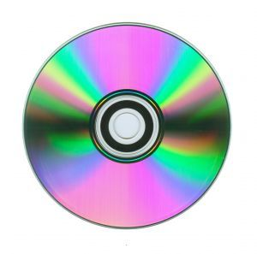
Kind of storage devices
4- Digital Versatile Disk (DVD):-
It’s a high capacity development of CD Rom and CD-R it can store a GB of information it’s used to store high quality films and videos.
It capacity is between 4.7-17 GB.

Slide 17
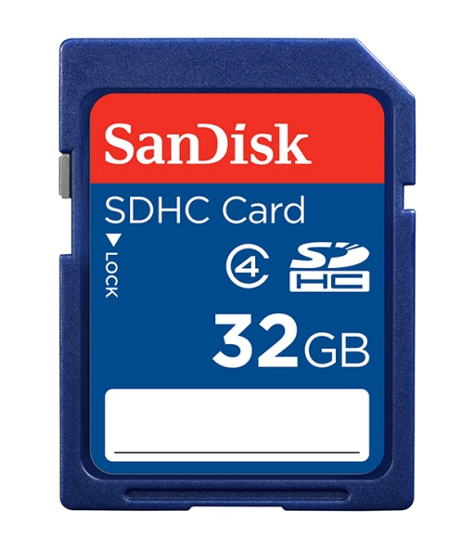
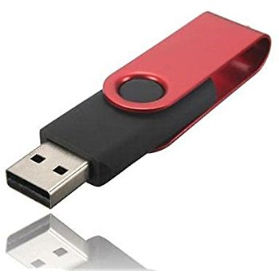
Kind of storage devices
5- Flash memory: -
It’s divided into blocks so it saves and erases information in fast way.

Slide 18
Thank You So Much

